Slide 1
Julian P. Kanter Political Commercial Collection

Slide 2
About the Collection
The Julian P. Kanter Political Commercial Collection is recognized internationally as a major source for political research and is one of the major sources for political commercials in the world.

Slide 3
About the Collection
Through the collection of television and radio political advertisements, film, social media, and other sources, the archive seeks to expand the knowledge and understanding of political communications, and the growth and changes in this field across the most significant and prolific era in world history.

Slide 4
About the Collection
Currently the Collection accounts for well over 120,000 political ads with thousands of un-accessioned items.

Slide 5
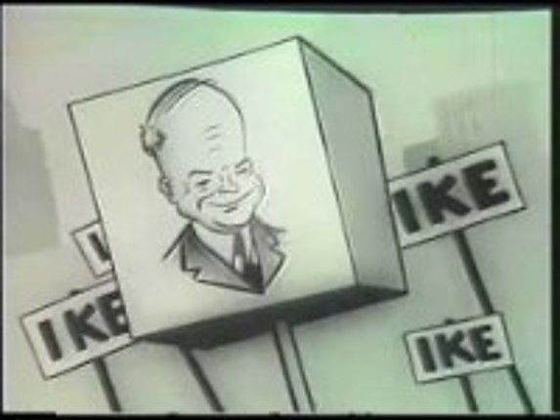
Dwight D. Eisenhower [Republican] 1952 Campaign Ad "You Like Ike - I Like Ike"

Slide 6
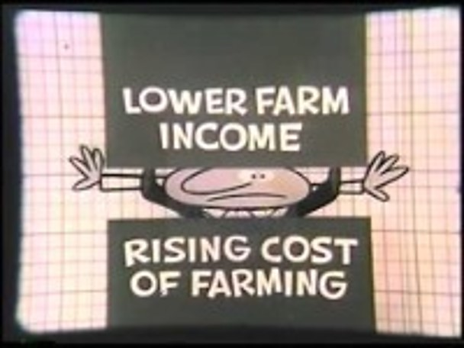
Adlai Stevenson [D-IL] 1956 Campaign Ad “Caught In A Squeeze?”

Slide 7
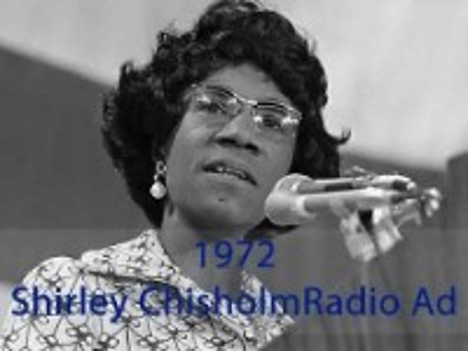
Shirley Chisholm 1972 Radio Ad “Women in Politics“

Slide 8
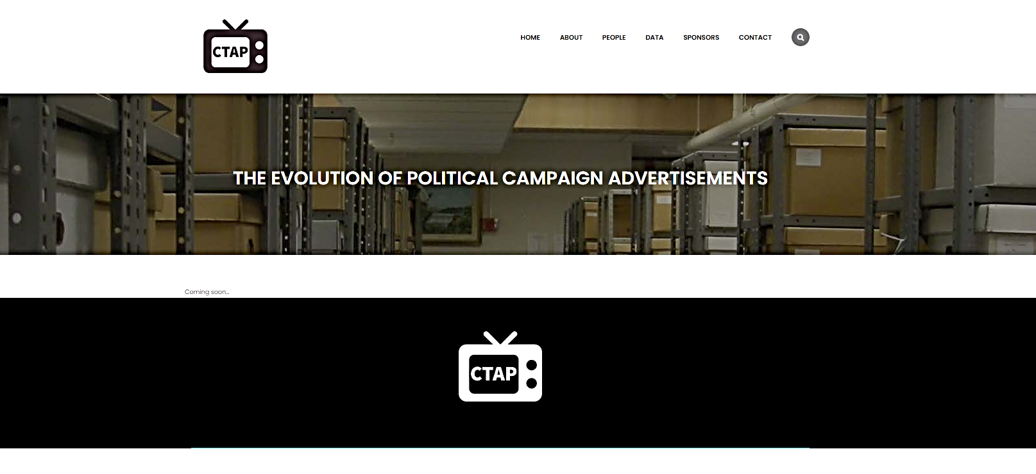
“Understanding the Evolution of Political Campaign Advertisements over the Last Century”
The collaboration with the NSF has led to the creation of the "Campaign Television Advertisement Project" website, which will be curated by Bryce Dietrich from Purdue University to host relevant content.
Notes:
2022, the Carl Albert Center, along with Harvard University and the University of Iowa, was awarded collaborative research grant funds for the project “Understanding the Evolution of Political Campaign Advertisements over the Last Century”

Slide 9
The project’s three specific aims:
Make a large underutilized collection of over 120,000 political ads (1912-2018) currently housed at the Carl Albert Center suitable for academic and non-academic research.
Understand the evolution of political advertising, especially as it pertains to issue advocacy and gender/minority representations prior to 1996.
Promote interdisciplinary graduate and undergraduate education in audiovisual analysis at research and teaching institutions.

Slide 10
The Centers' task focused on the first aim
Provide reliable content for collaborator analysis.
Notes:
Seems easy enough right?

Slide 11
Quick background and relationship with collection
February 3, 2022
Grant awarded
March 15, 2020
Campus locked down
November 2020
First access to storage
Site in disarray
Collection aggregation project begins
123,000+ unique files
Collection storage redesign
1st model tested – Presidential Ads
Spring of 2019
University of Oklahoma experienced financial issues contributing to closing or cutting funding for campus collecting repositories
January 13, 2021
Grant proposal submitted to NSF
Limited or NO access to digital or physical collection
2019
2019
2020
COVID
2020
2020
2021
2022
Current
February 2020
The Center receives partial worksheets
Physical Collection access still restricted
Project discussions with collaborators
April 28, 2020
Center receives updated partial sheet
Items and inventory incongruent
Missing information
Inventory discrepancies
Continued campus lockdown, no keys to Collection storage
Collection digital items are not accessible
Continuous collection aggregation, data cleansing, standardization, preservation
August 2019
The Center authority to access
Requests inventories, finding aids, catalogs location guide
Requests keys to collection storage
Notes:
One of the repositories set for closure was the Julian P. Kanter Archive which once operated under the Communications Department

Slide 12
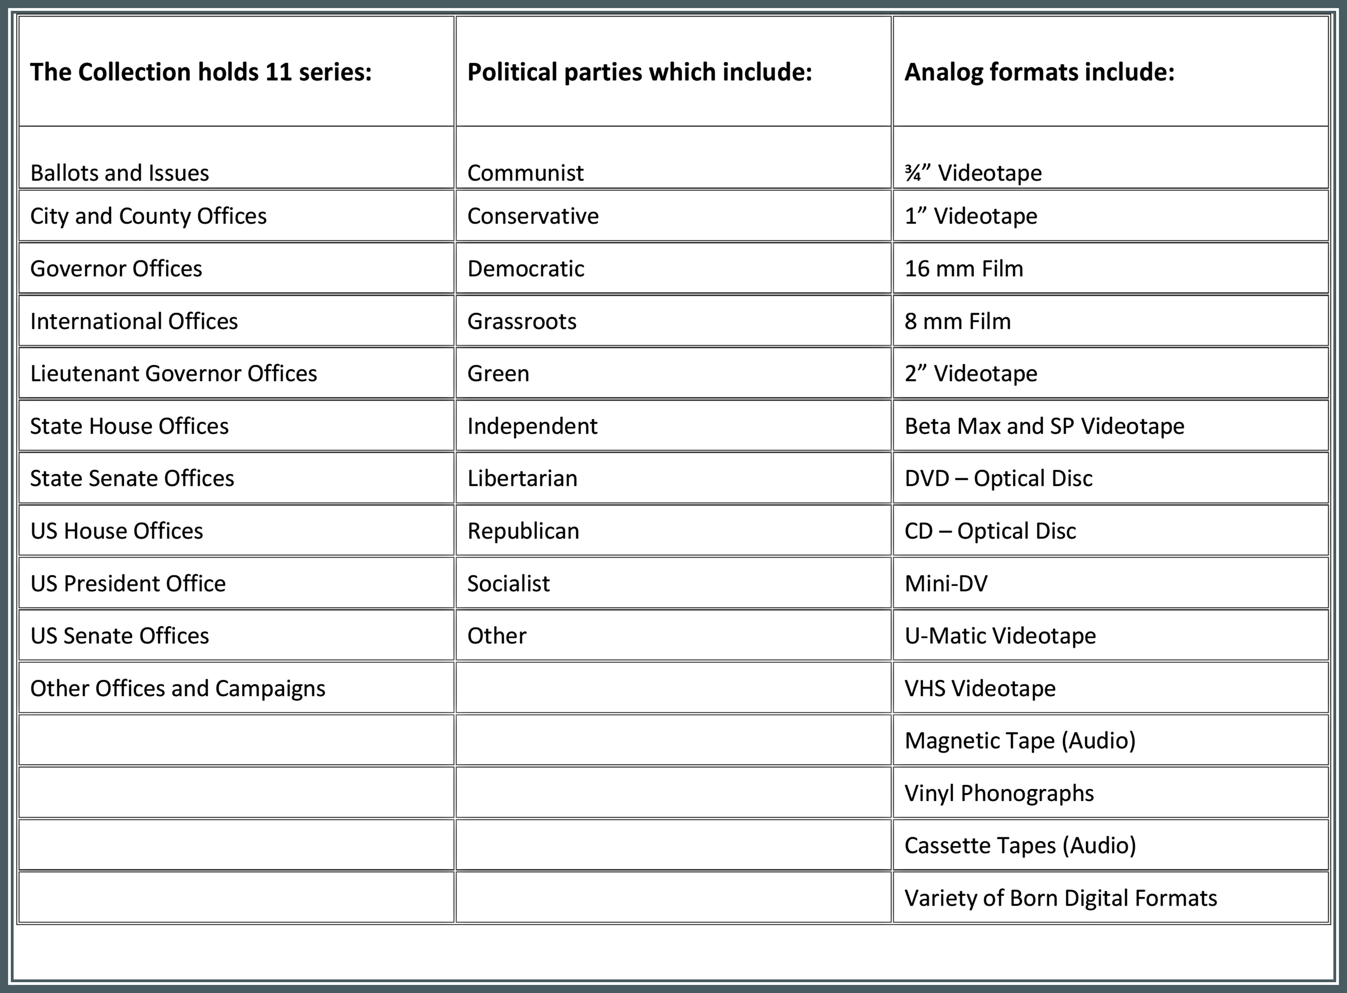
Expectations and assumptions
Notes:
The Collection was organized by umbrella headings or groups:
State Senate Offices
US Senate Offices
US Presidential Office
But also
City and County Offices
Ballots and Issues
‘Other Offices”
Likewise Parties included the most commonly seen and everything else was blank or ‘other’

Slide 13
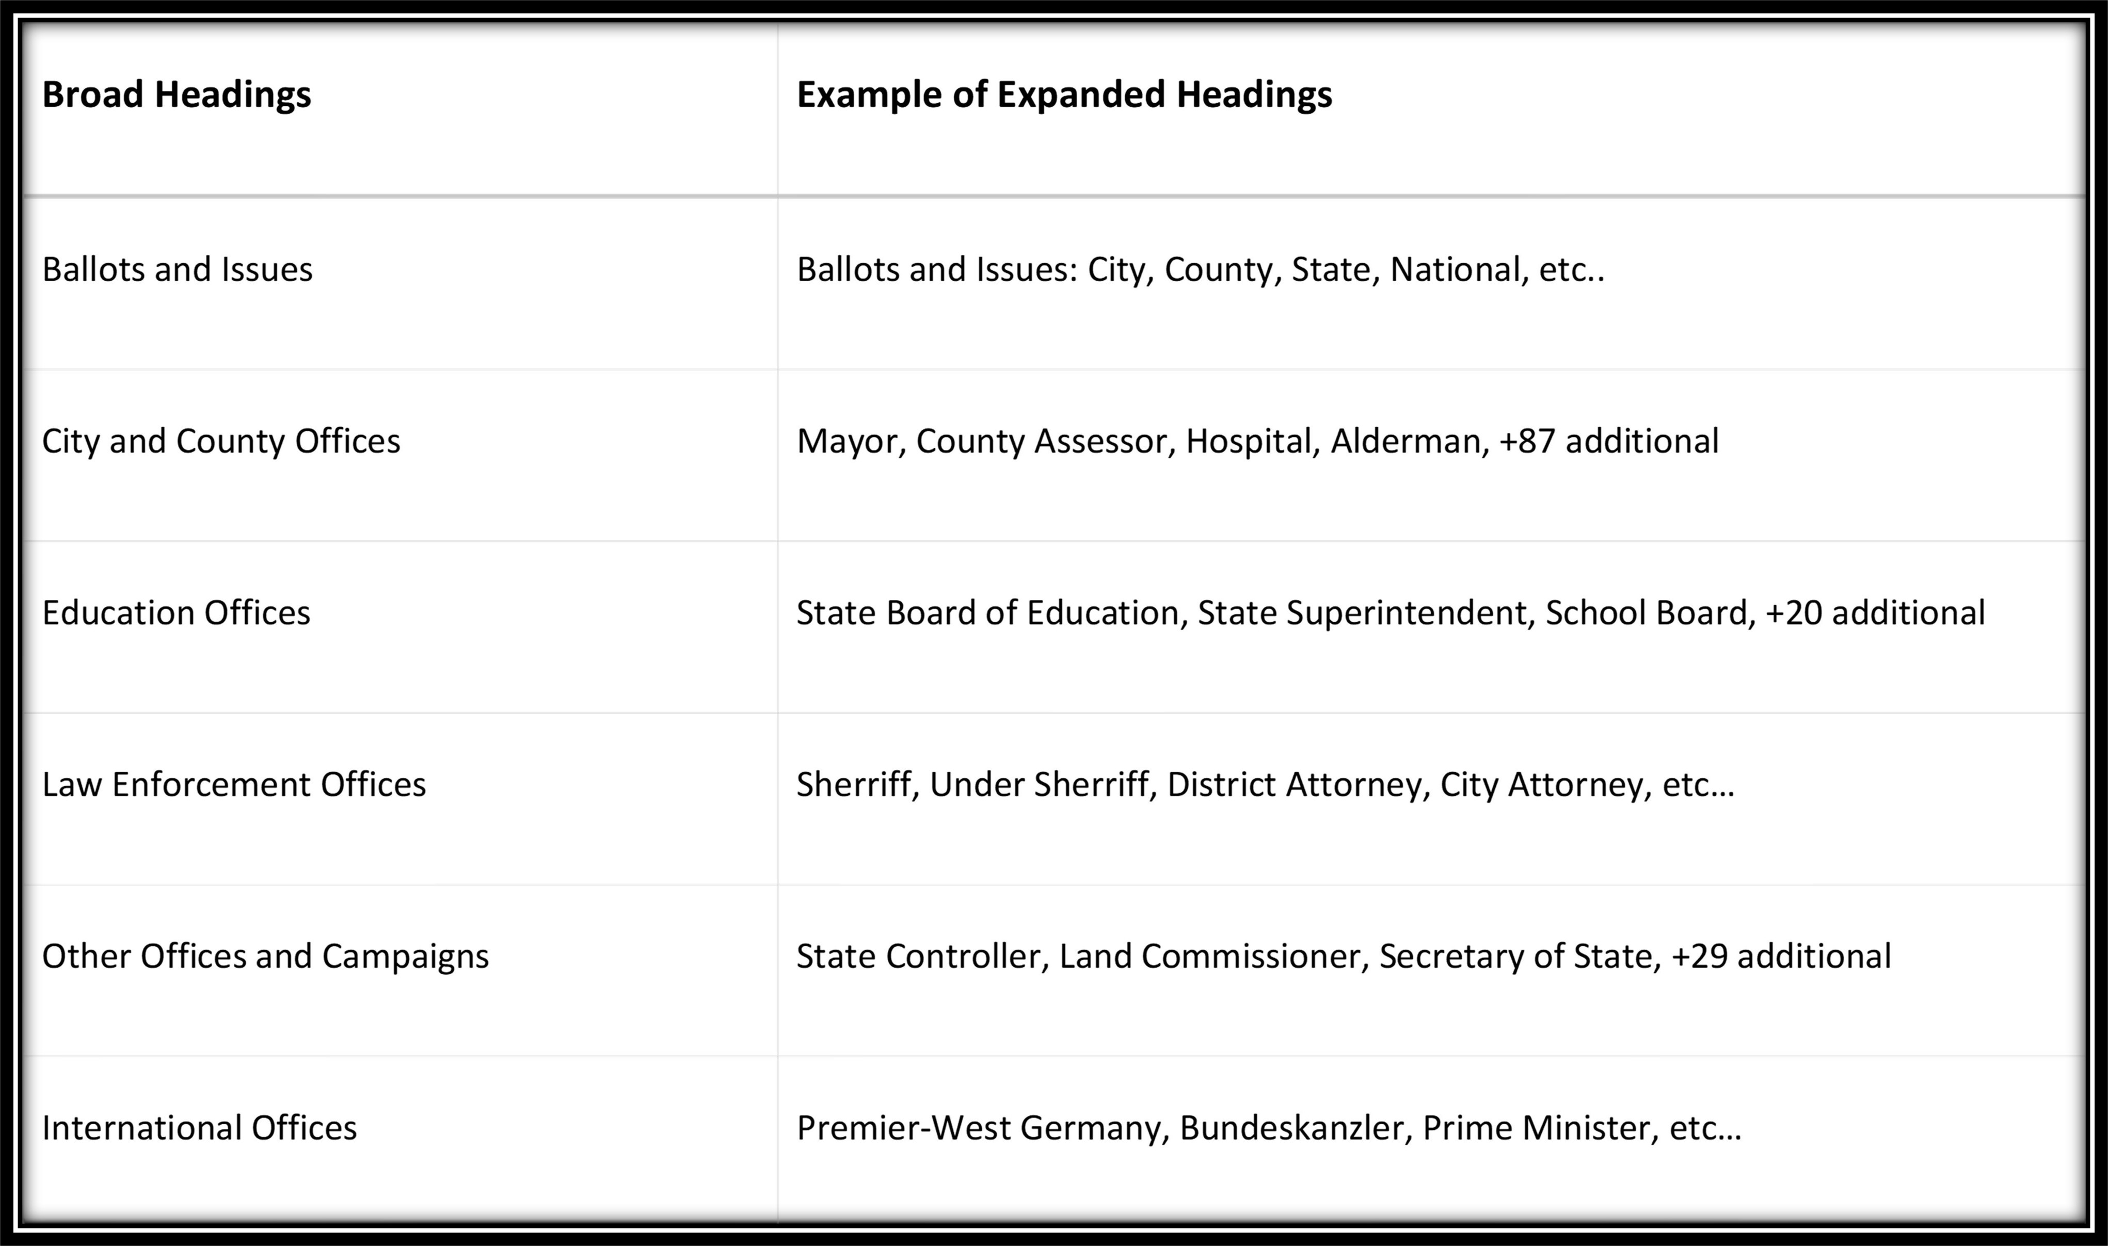
Headings
The Collection holds several series and hundreds of sub-series
Notes:
The Collection was organized by umbrella headings or groups:
State Senate Offices
US Senate Offices
US Presidential Office
But also
City and County Offices
Ballots and Issues
‘Other Offices”
Likewise, Parties included the most commonly seen and everything else was blank or ‘other’
As we processed the Collection, we quickly recognized the need to develop more comprehensive hierarchy
Sub-series were created to identify which City and County Office – which Education Offices – Which Other Offices
I am not going to address the latter phases or current phases of the project this afternoon, but this is ongoing as we re-digitize or migrate the ads as we have noticed automated detection models have confused particular ads that do not state the office**

Slide 14
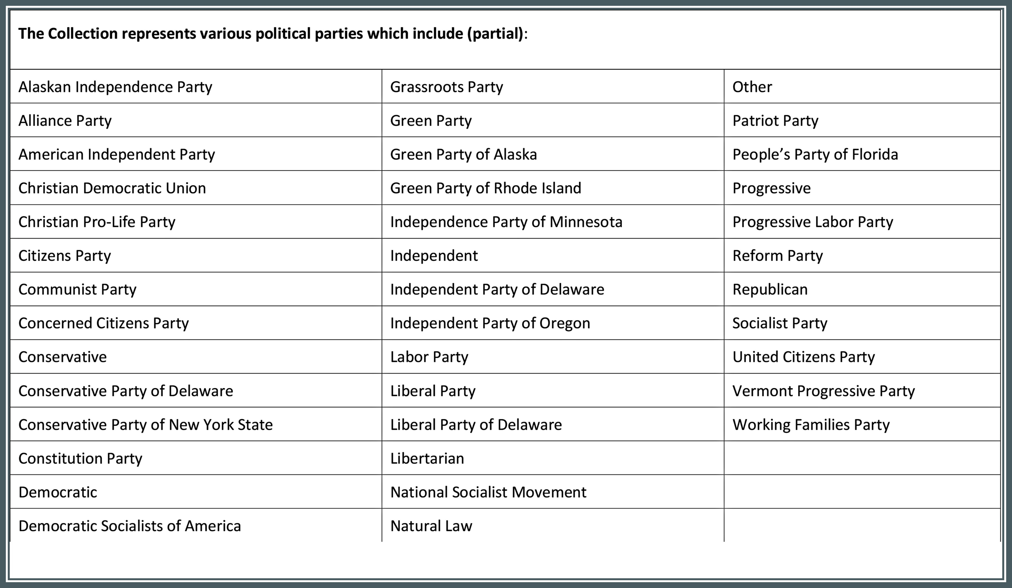
Ongoing collection analysis
Notes:
This process is the same for parties, and all other sub-groupings
Obviously, the dataset rapidly expanded
As you can see the increase in data included identification of accurate parties. Tens of thousands of ads did not have identification or inaccurate identification

Slide 15
Existing collection formats
Analog formats include:
¾” Videotape | U-Matic Videotape
1” Videotape | VHS Videotape
16 mm Film | Magnetic Tape (Audio)
8 mm Film | Vinyl Phonographs
2” Videotape | Cassette Tapes (Audio)
Beta Max and SP Videotape | Variety of Born Digital Formats
DVD – Optical Disc | Mini-DV
CD – Optical Disc
Notes:
It is important to mention that the Collection is stored in many diverse formats, adding further complexities to its management.
However, I want to emphasize that despite these challenges, I have a strong passion for this work – my true love

Slide 16
Original arrangement

Slide 17
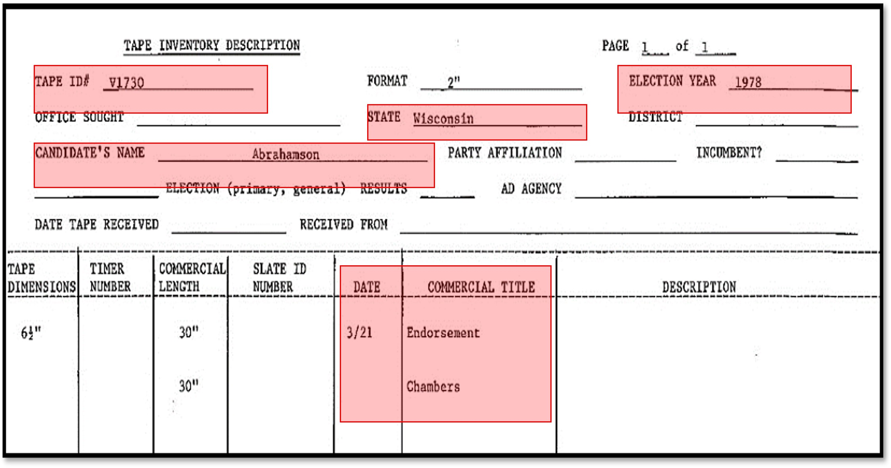
Arrangement and Original Order
1978 - First compiled evidence of inventory was recorded by hand and transferred to standardized form in 1985.
Notes:
Partial lists sent to the Center in 2019-2021 included numerous thousands of individual lists, catalogs and notes that contained information about the advertisements.
However, these documents varied in formats and stored across several mediums and locations, including paper, internal and external hard drives, servers, cloud storage and local networks.
The ‘master’ inventory offered to the Center from PCC management consisted of a partial amalgamation of data collected by students from the late 1980s through 2018.

Slide 18
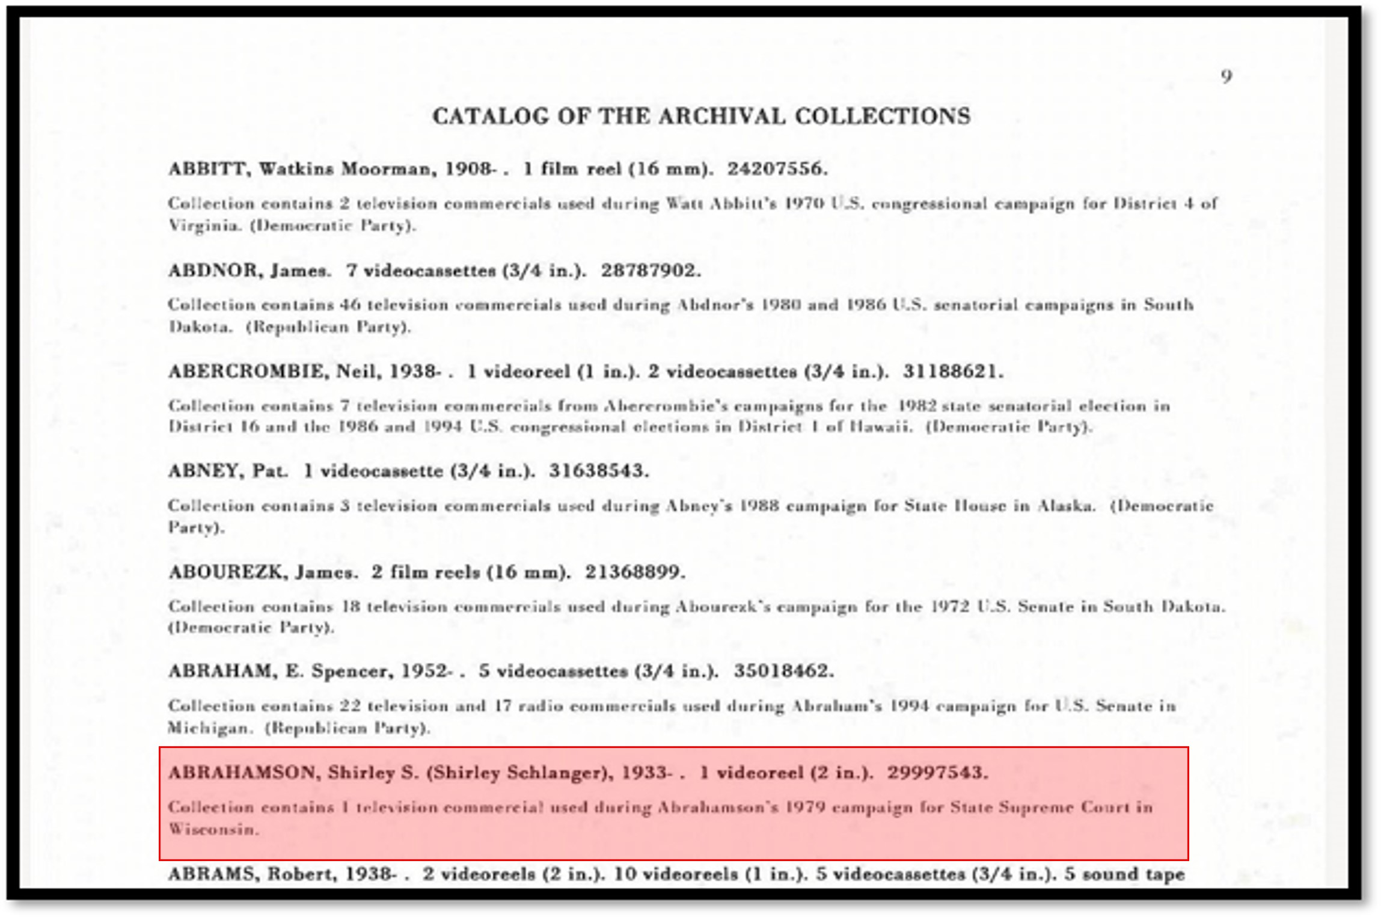
Arrangement and Original Order
1990 - A comprehensive catalog created in 1990 documented by original order with the addition of OCLC number.
Notes:
A comprehensive catalog created in 1990 documented by original order with the addition of OCLC access number, if available, which was assigned using the Archives and Manuscript Control format (AMC)
Frequently, item level descriptive data were absent and with limited legacy metadata.
We do not know why this was done and have no documentation.

Slide 19
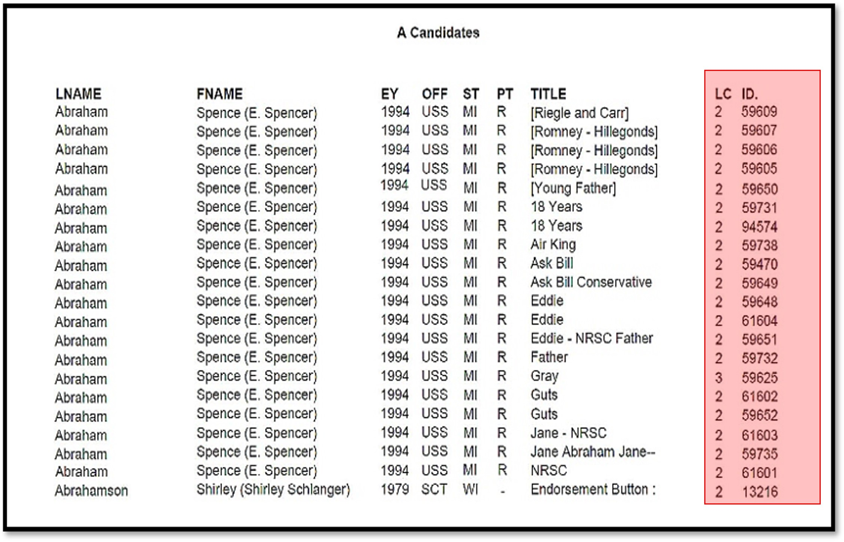
Arrangement and Original Order
2003 – In 2003 an updated Collection catalog accounted for 70,000 items
Notes:
An updated Collection catalog created in 2003 counted 70,000 items represented by three parts (**note: The updated catalog was absent of identification numbers from either 1985, 1990, or 1996 as to WHY or how the new identification numbers were created**)
candidate’s last name,
election year, office, party, and
title, length of commercial, and ‘new’ identification number [see image ####].

Slide 20
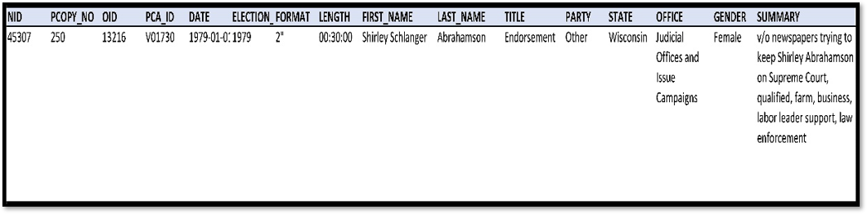
Arrangement and Original Order
2014 – In 2014 the Political Communications Center received a grant from NEH to ‘digitize’ the moving image formats, creating a new catalog and more comprehensive finding aid for the collection.
Notes:
In 2014, metadata included more comprehensive information from previous catalogs with additional elements compiling identification numbers from previous catalogs and the
addition of a heading titled ‘P_COPY’.
the P_COPY identification number was a reformative, fundamental change to identifying items in the collection.
Added ‘NID’, ‘PCOPY’ identification numbers
Included 1978 and 2003 identification numbers
Aggregated year, format, name, title, state, office, and summary

Slide 21
Quick RECAP
1978 | Original arrangement was alphabetical according to the candidate’s name with two parts, (1) an entry line with name, physical format; and (2) a brief description of the candidate, a list of items related to the candidate, and where possible the political party and specific election year
1990 | Catalog created in 1990 documented by original order with the addition of OCLC access number
2003 | Updated Collection catalog created in 2003 represented by three parts (1) candidate’s last name, (2) election year, office, party, and (3) title, length of commercial, and ‘new’ identification number
2014 | 2019, metadata included more comprehensive information from previous catalogs with additional elements compiling identification numbers from previous catalogs and the addition of a heading titled ‘P_COPY’.
Notes:
In 2014, metadata included more comprehensive information from previous catalogs with additional elements compiling identification numbers from previous catalogs and the
addition of a heading titled ‘P_COPY’.
the P_COPY identification number was a reformative, fundamental change to identifying items in the collection.

Slide 22
Quick count RECAP
1985 | 25,000 ads – original collection presidential with groups of both congressional and gubernatorial ads between the years 1952-1956
1996 | 56,000 ads – continued collection growth – presidential, congressional, gubernatorial - expanded to include broader range of offices
2003 | 70,000 ads – continued collection growth (first account of +10,000 ‘unprocessed’ ads)
2009 | 90,000 ads – steady collection increase with second report of an additional 40-100 boxes that had not been “opened” (this could potentially account for tens of thousands of ads)
2012 | 125,000 (110,000-125,000) ads – documentation found in the collection notes and university publications accounts for a range of 110,000 – 125,000 ads in the collection with various notes of ‘significant transition from collecting 'physical' materials to collecting ads as they are posted on the Internet or from other born-digital sources)
2019 | 119,000 ads – deduced from 2019 Center counts from hundreds of partial inventories and catalogs (this doe NOT account for items not processed or cataloged)
2023 | 123,000 unique ads AND over 108,000 un-accessioned ads (estimated combined born-digital and analog)
Notes:
In 2014, metadata included more comprehensive information from previous catalogs with additional elements compiling identification numbers from previous catalogs and the
addition of a heading titled ‘P_COPY’.
the P_COPY identification number was a reformative, fundamental change to identifying items in the collection.

Slide 23





Location of files
27 individual computer drives (MAC and PC)
8 antiquated ‘servers’ containing 4, 8, 12 drives
Multiple cloud platforms (with various log-in)
71 external hard drives-multiple generations
Intra- and Internet databases

Slide 24
(Re)processing – Linear Reciprocity Model

Slide 25
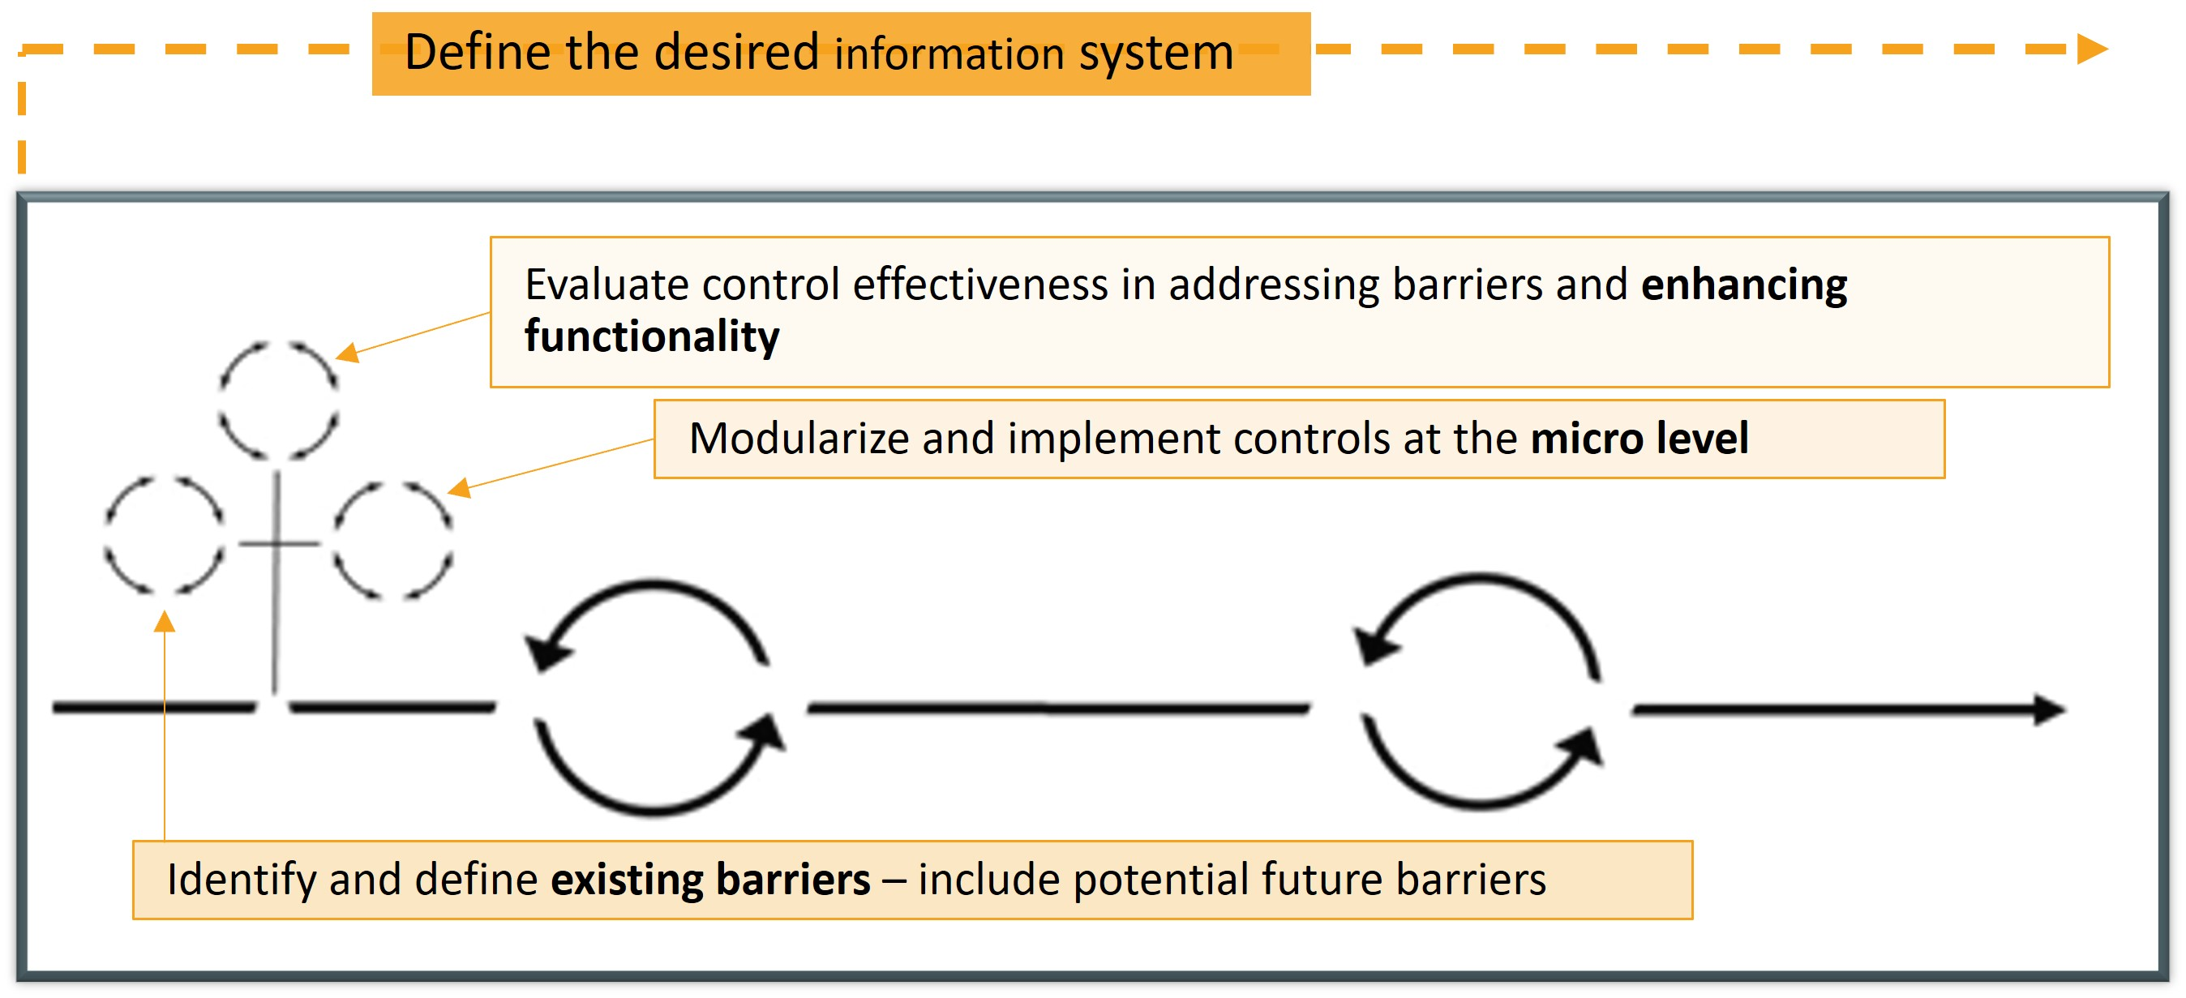
Linear Reciprocity Model
#1
Define the desired information system
Identify and define existing barriers, including potential future barriers
Identify and define system control mechanisms required to create #1
Modularize and implement controls at the micro level to regulate and monitor individual components, processes, and interactions
Test controls at each micro level
Notes:
So, with possible collaboration efforts in the work, funding allocated to the Collection, and several existing large-scale projects currently in the works……..
It was IMPERATIVE to design a workflow and a system to address the impossibility.
The primary emphasis of my entire career research has centered on the development of my theory or model
This presentation will address the Initial steps to implementation of the Linear Reciprocity Model:
Define the desired information system
Identify and define existing barriers – include potential future barriers
Identify and define system control mechanisms (what do we need to create #1)
Modularize and implement control mechanisms at the micro level (regulating and monitoring individual components, processes, and interactions, ensuring accuracy, security, and reliability)
Test controls at each micro level - After completing the steps mentioned earlier, the next step in the research process would typically involve evaluating and analyzing the effectiveness of the implemented controls at the micro level. This evaluation aims to assess how well the controls address the identified barriers and contribute to the desired functioning of the information system.

Slide 26
#2
Items in MANY different storage places
Corrupt/broken technology
Identifier inconsistency and errors
Title errors and inconsistency in format
Name inconsistencies errors/misrepresentations
Pre and suffix errors and inconsistency
Duplicate files
Acronym consistency (acronyms in general)
Party misidentification
Short-hand and abbreviated text
Offices misidentified
Data format inconsistency
State identification inconsistency errors
Incorrect numbering (out of order)
Creators/agency misrepresentation inconsistency
Languages inconsistency or misidentified
Length and extent inconsistency
Subject development
Initial analysis– obvious Barriers
Notes:
NEXT – identify barriers:
With the amount of data accompanying the Collection it is priority to organize and standardize as many elements as possible for cohesiveness and maintenance.
Some issues found early in the Collection include:
Corrupt or fractured data
Duplicates
Located all over the place
Complex inconsistencies
How do we recover items and what items are worth recovering? How will we know what is essential and what is derivative, dupe, bad file?

Slide 27
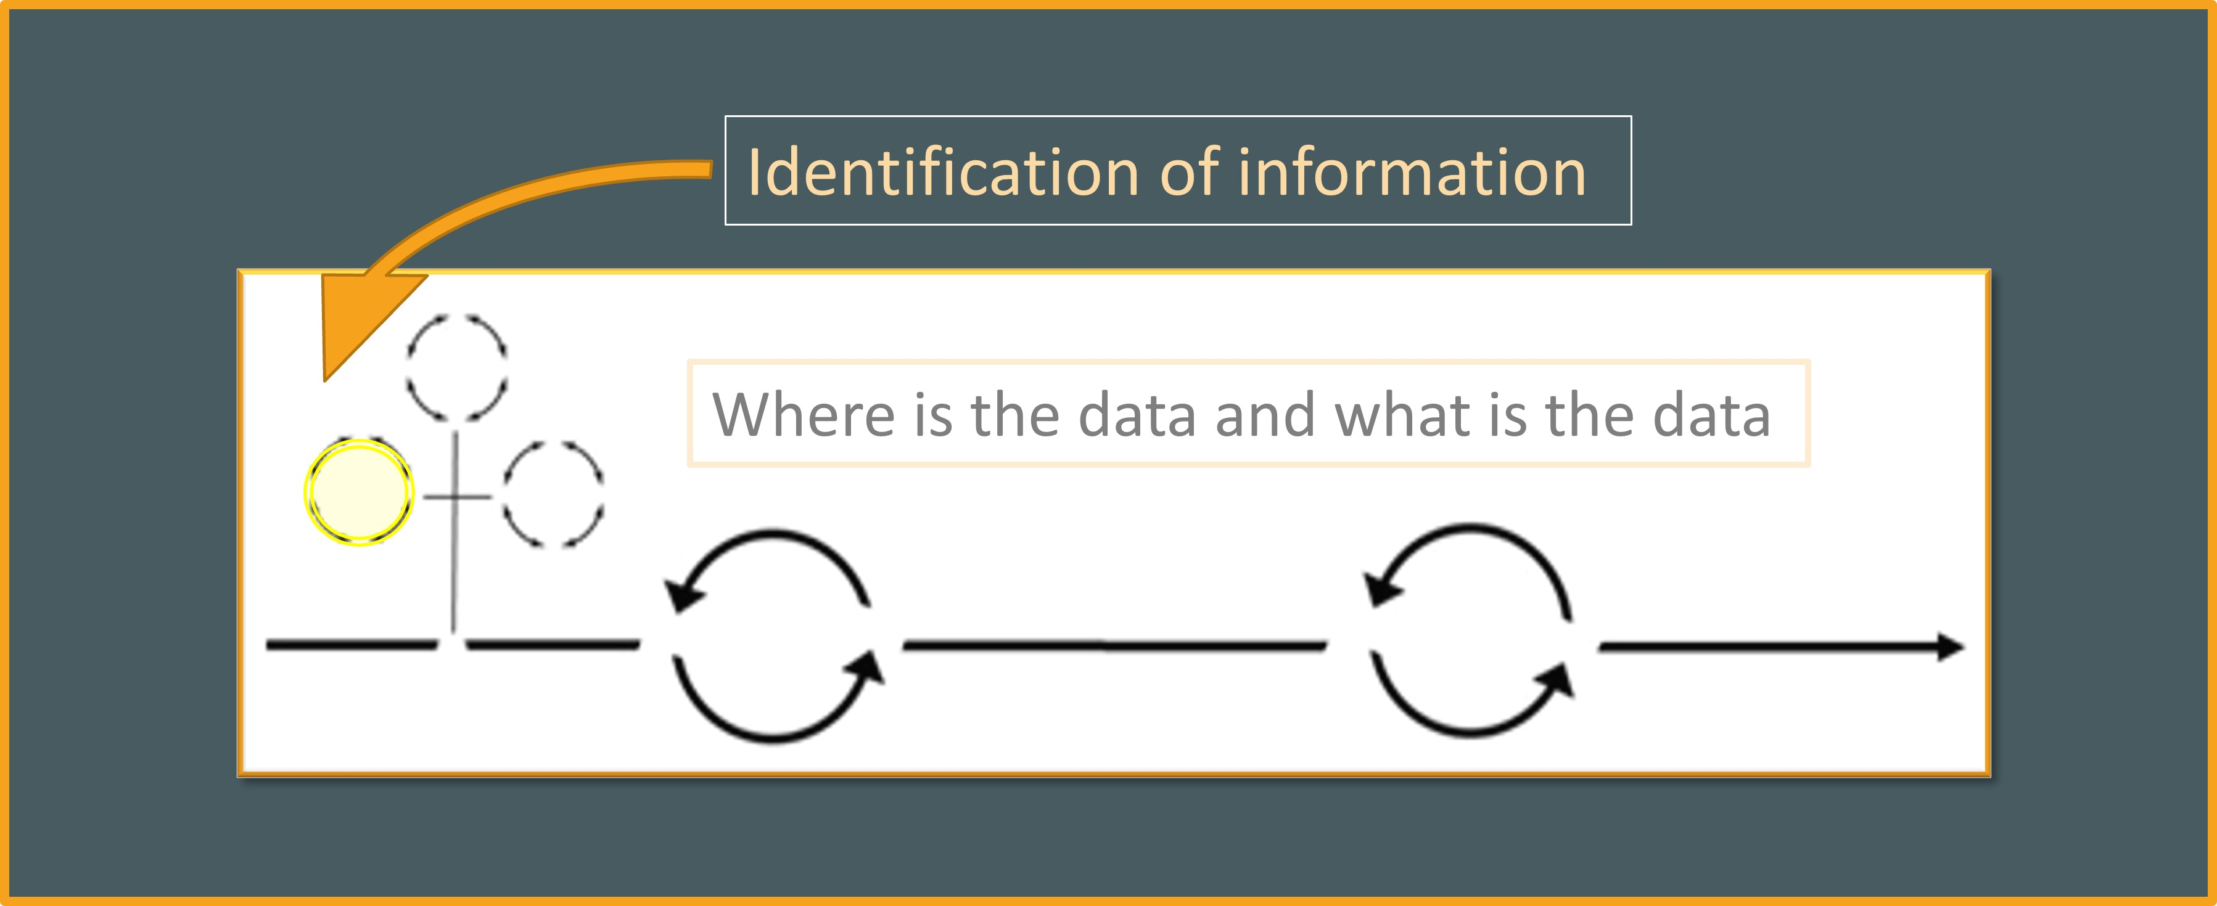
Linear Reciprocity Workflow
Notes:
Example – each of the initial phase controls fall into a micro element our defined information system
Identification of information contains a series of cyclical processes

Slide 28
Information system
Existing System
Index/
Catalogue
Digitization
Selection
DAM
Mission
Policy
Preservation
Conservation
Master/Access
Funding
Test
Staff Training
Metadata
Checksum
TDR
Storage
Integrate this new collection into the existing archival information system by:
Mapping the data from the new collection to align with the established system's data model
Applying archival workflow standards and product
Collection Integration
Index/ Catalog
Standardize
Master/Access
DAM
Stream
Preservation
Conservation
Digitization
Metadata
Checksum
Test
TDR
Storage
Notes:
In defining the information system goals I had to:
What do we have in place?
How do we currently ingest collections?
Who is our audience? – does this differ from our existing collections?
How do we disseminate: objects, stream, loans, virtual?
The new collection data has its own distinct structure, metadata, and scope, representing unique content and information. However, in order to enhance accessibility and ensure seamless management, it is necessary to integrate this new collection into the existing archival information system. This integration involves mapping the data from the new collection to align with the established system's data model, standards, and organizational hierarchy. By doing so, the new collection becomes a cohesive part of the broader archival landscape, allowing users to navigate and explore the combined resources more effectively.

Slide 29
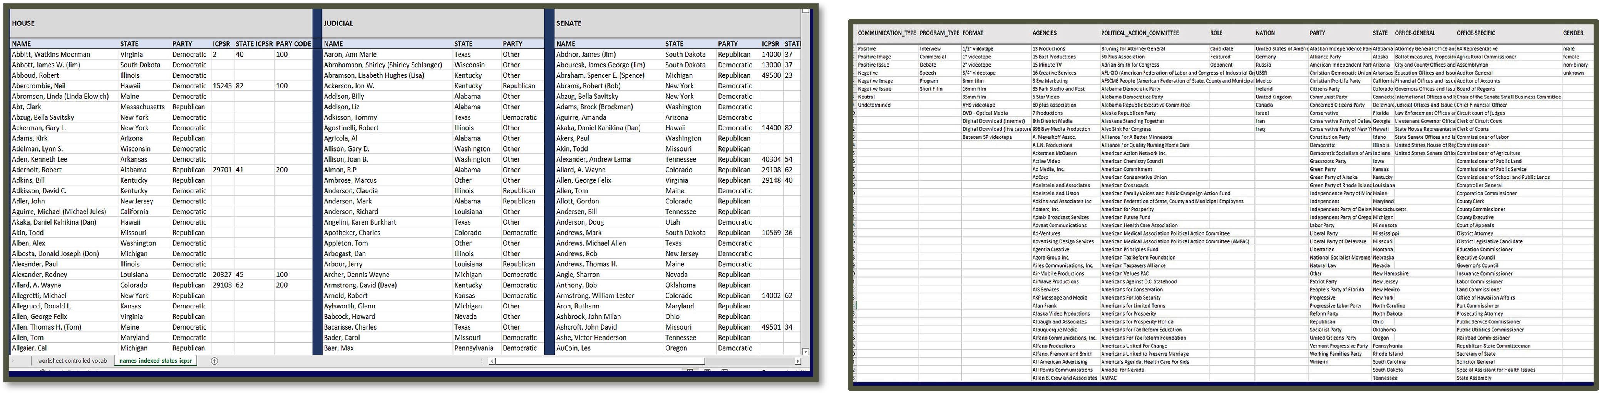
Initial Control elements
#3
Data aggregation: Consolidate large volumes of diverse data from multiple sources into a unified dataset.
Notes:
APPLY CONTROLS:
The first step or control is:
1. Data aggregation: - Consolidate large volumes of diverse data from multiple sources into a unified dataset.

Slide 30
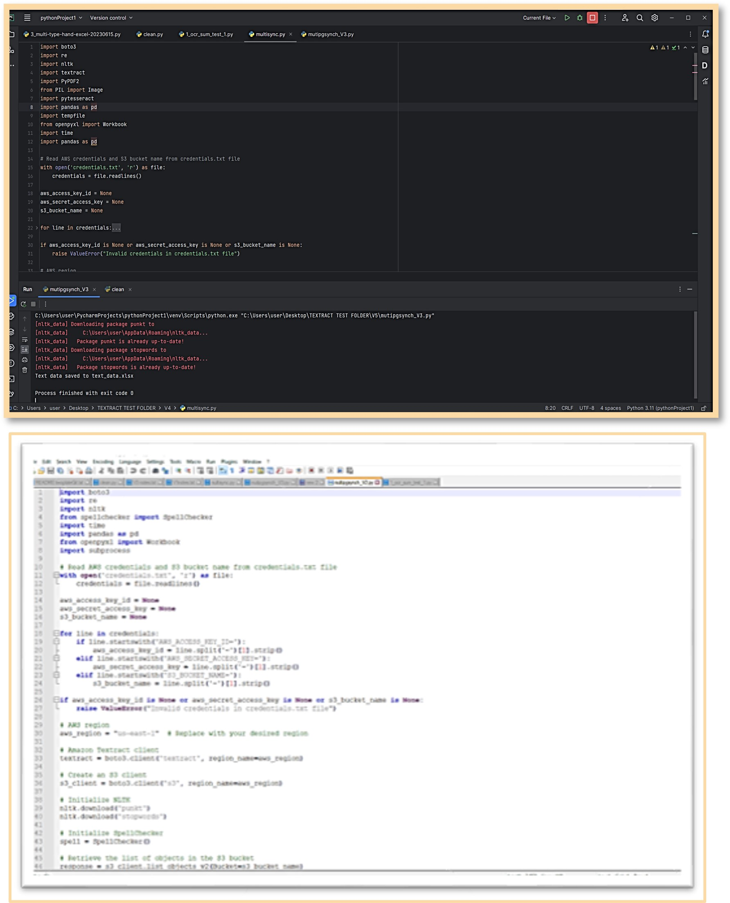
Initial Control elements
Data integration: Combine data from disparate sources into a coherent format
Data warehousing: Create a central repository.
Notes:
Now that we have one working base we combine data from disparate sources into a coherent format through automated coding created after analysis of full dataset.
Mixed in this presentation with #3 for sake of time - Data warehousing: Create a central repository.
Preferred method – custom scripting – PYTHON and RapidMiner (extra cleaning)
Ability to define functionalities
Ability to import or create/develop controlled access headings, subjects, terminology
Ability to implement both pre-processing and post-processing structures
Easily edited!
Amazon S3 – for easy running code and storing data
OR GitLab for remote access

Slide 31
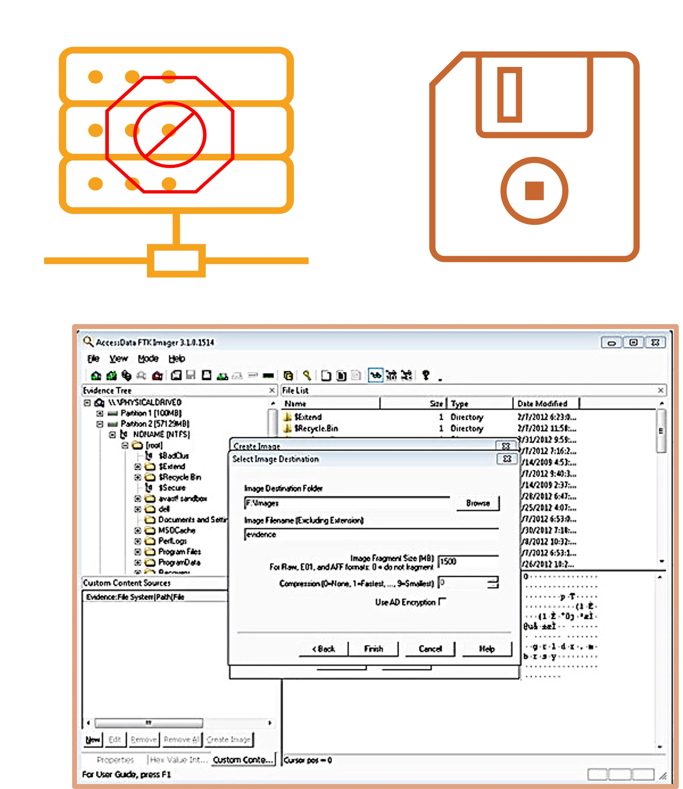
Initial Control elements
Digital Forensics: In most cases forensic tools were needed to extract data from obsolete media, files, and platforms
Notes:
With this we found: Broken hard drives – corrupt servers – no access to networks – username and passwords for each PC or Mac – formats, obsolete data storage – floppy disks
We recovered ‘lost’ or deleted files, system logs, and fragments of overwritten or damaged data by employing digital forensic techniques.
With a more comprehensive dataset, our automated algorithms can effectively learn and adapt to the characteristics of the data.
This enables better discovery of the subtle correlations, and dependencies that contribute to the overall pattern detection
Analyzing this amount of data with one full-time Archivist and one part-time student would clearly be impossible.

Slide 32
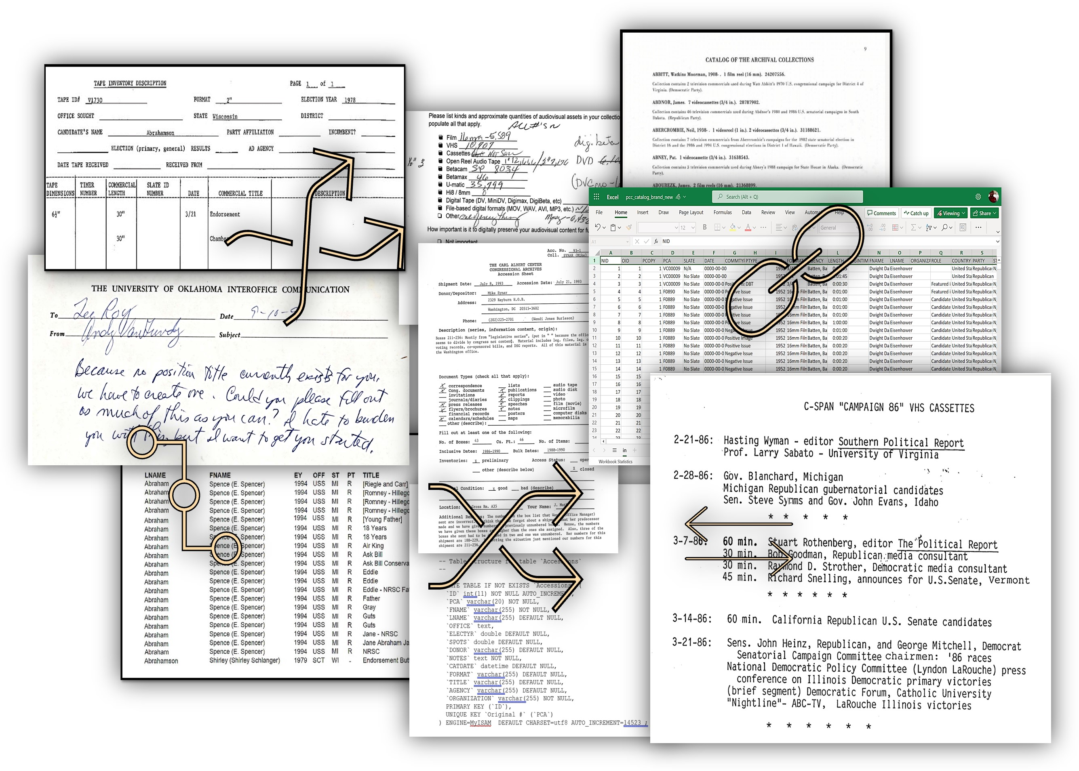
LINK ALL OF THE RECORDS STRUCTURED AND UNSTRUCTURED
Notes:
At this point we had gathered all the information that was readily accessible to us.
We had to ingest thousands of ‘pages’ of information just to establish baseline control. (CHAOS)
Next, through the use scripts or code we could apply automated algorithms to streamline the processing and analysis of the extensive dataset.
Now we were able to handle the data in an efficient manner, extracting valuable information and uncovering meaningful patterns, or recurring structures, trends, or associations within the dataset that provide deeper understanding or predictive capabilities.
The analysis produced a substantial volume of output data

Slide 33
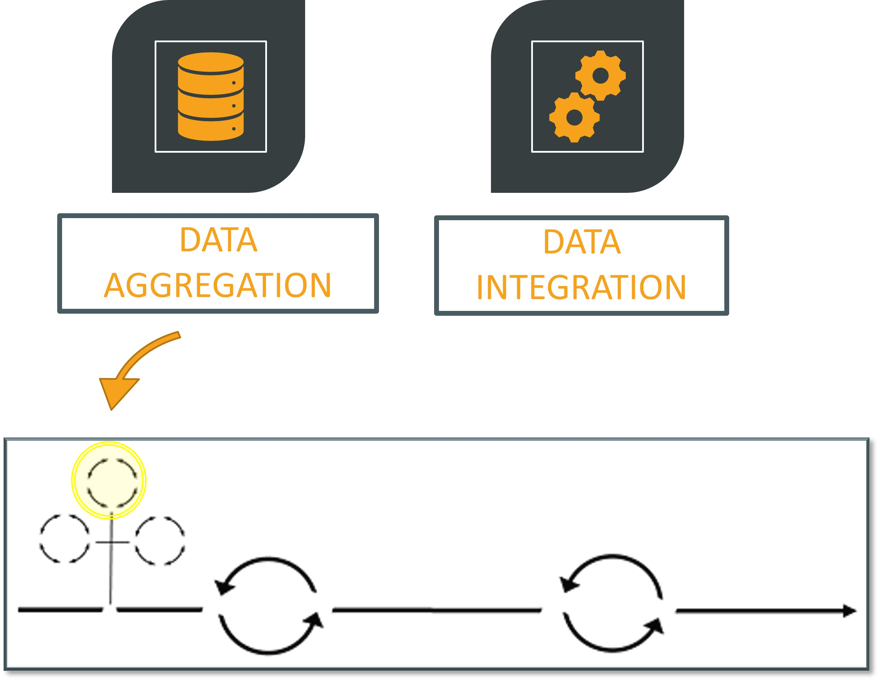
Linear Reciprocity Workflow
#4
Notes:
In order to identify and analyze the collection in greater detail, extract additional pattern of errors or variation requires the use of comparison algorithms and collection specific methodologies. By developing fundamental platforms of analysis, the level of similarity or differences between files can be measured more accurately to depict uniqueness. This approach contributes to the effective organization of the collection and ensures that each item is accurately classified based on its specific characteristics

Slide 34

Remember ‘lockdown’
Notes:
At this time, students were restricted to remote access and work.
The model dictates we integrate new collections into the existing information system, but the complexity of this process now faces increasing limitations
The pressure is ramping up from internal and external influences (we have a very short amount of time to show worth of the Collection By the Way)

Slide 35
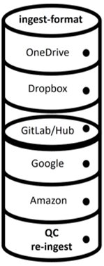
Remote Student/staff access
1 Archivist + 1 Business Student
Divide master sheet
Assign ‘chunks’ to students
Group A
Group B
Group C
Implement QA controls
A
B
A
B
A
B
C
C
C
C
R
R
Notes:
The combined sheet was enormous, though relatively great scripts and packages were applied, the data STILL had a long remote way to go.
Cleaning data – NOW not all students are tech savvy nor are library and information students – during lockdown we had business students, journalism students, finance students, and many history students
*** very few had experiences***
2020 – could have PER SEMESTER 17 interns, 1 GA, 1 part-time undergrad
2021 – PER SEMESTER 22 interns, 1 GA, 2 part-time undergrads
2022 – PER SEMESTER 11 interns, 2 GA, 2 part-time undergrads
2023 – same as 2022
UNIVERSITY RESTRICTED ACCESS not to mention remote student access issues for various cloud sources

Slide 36
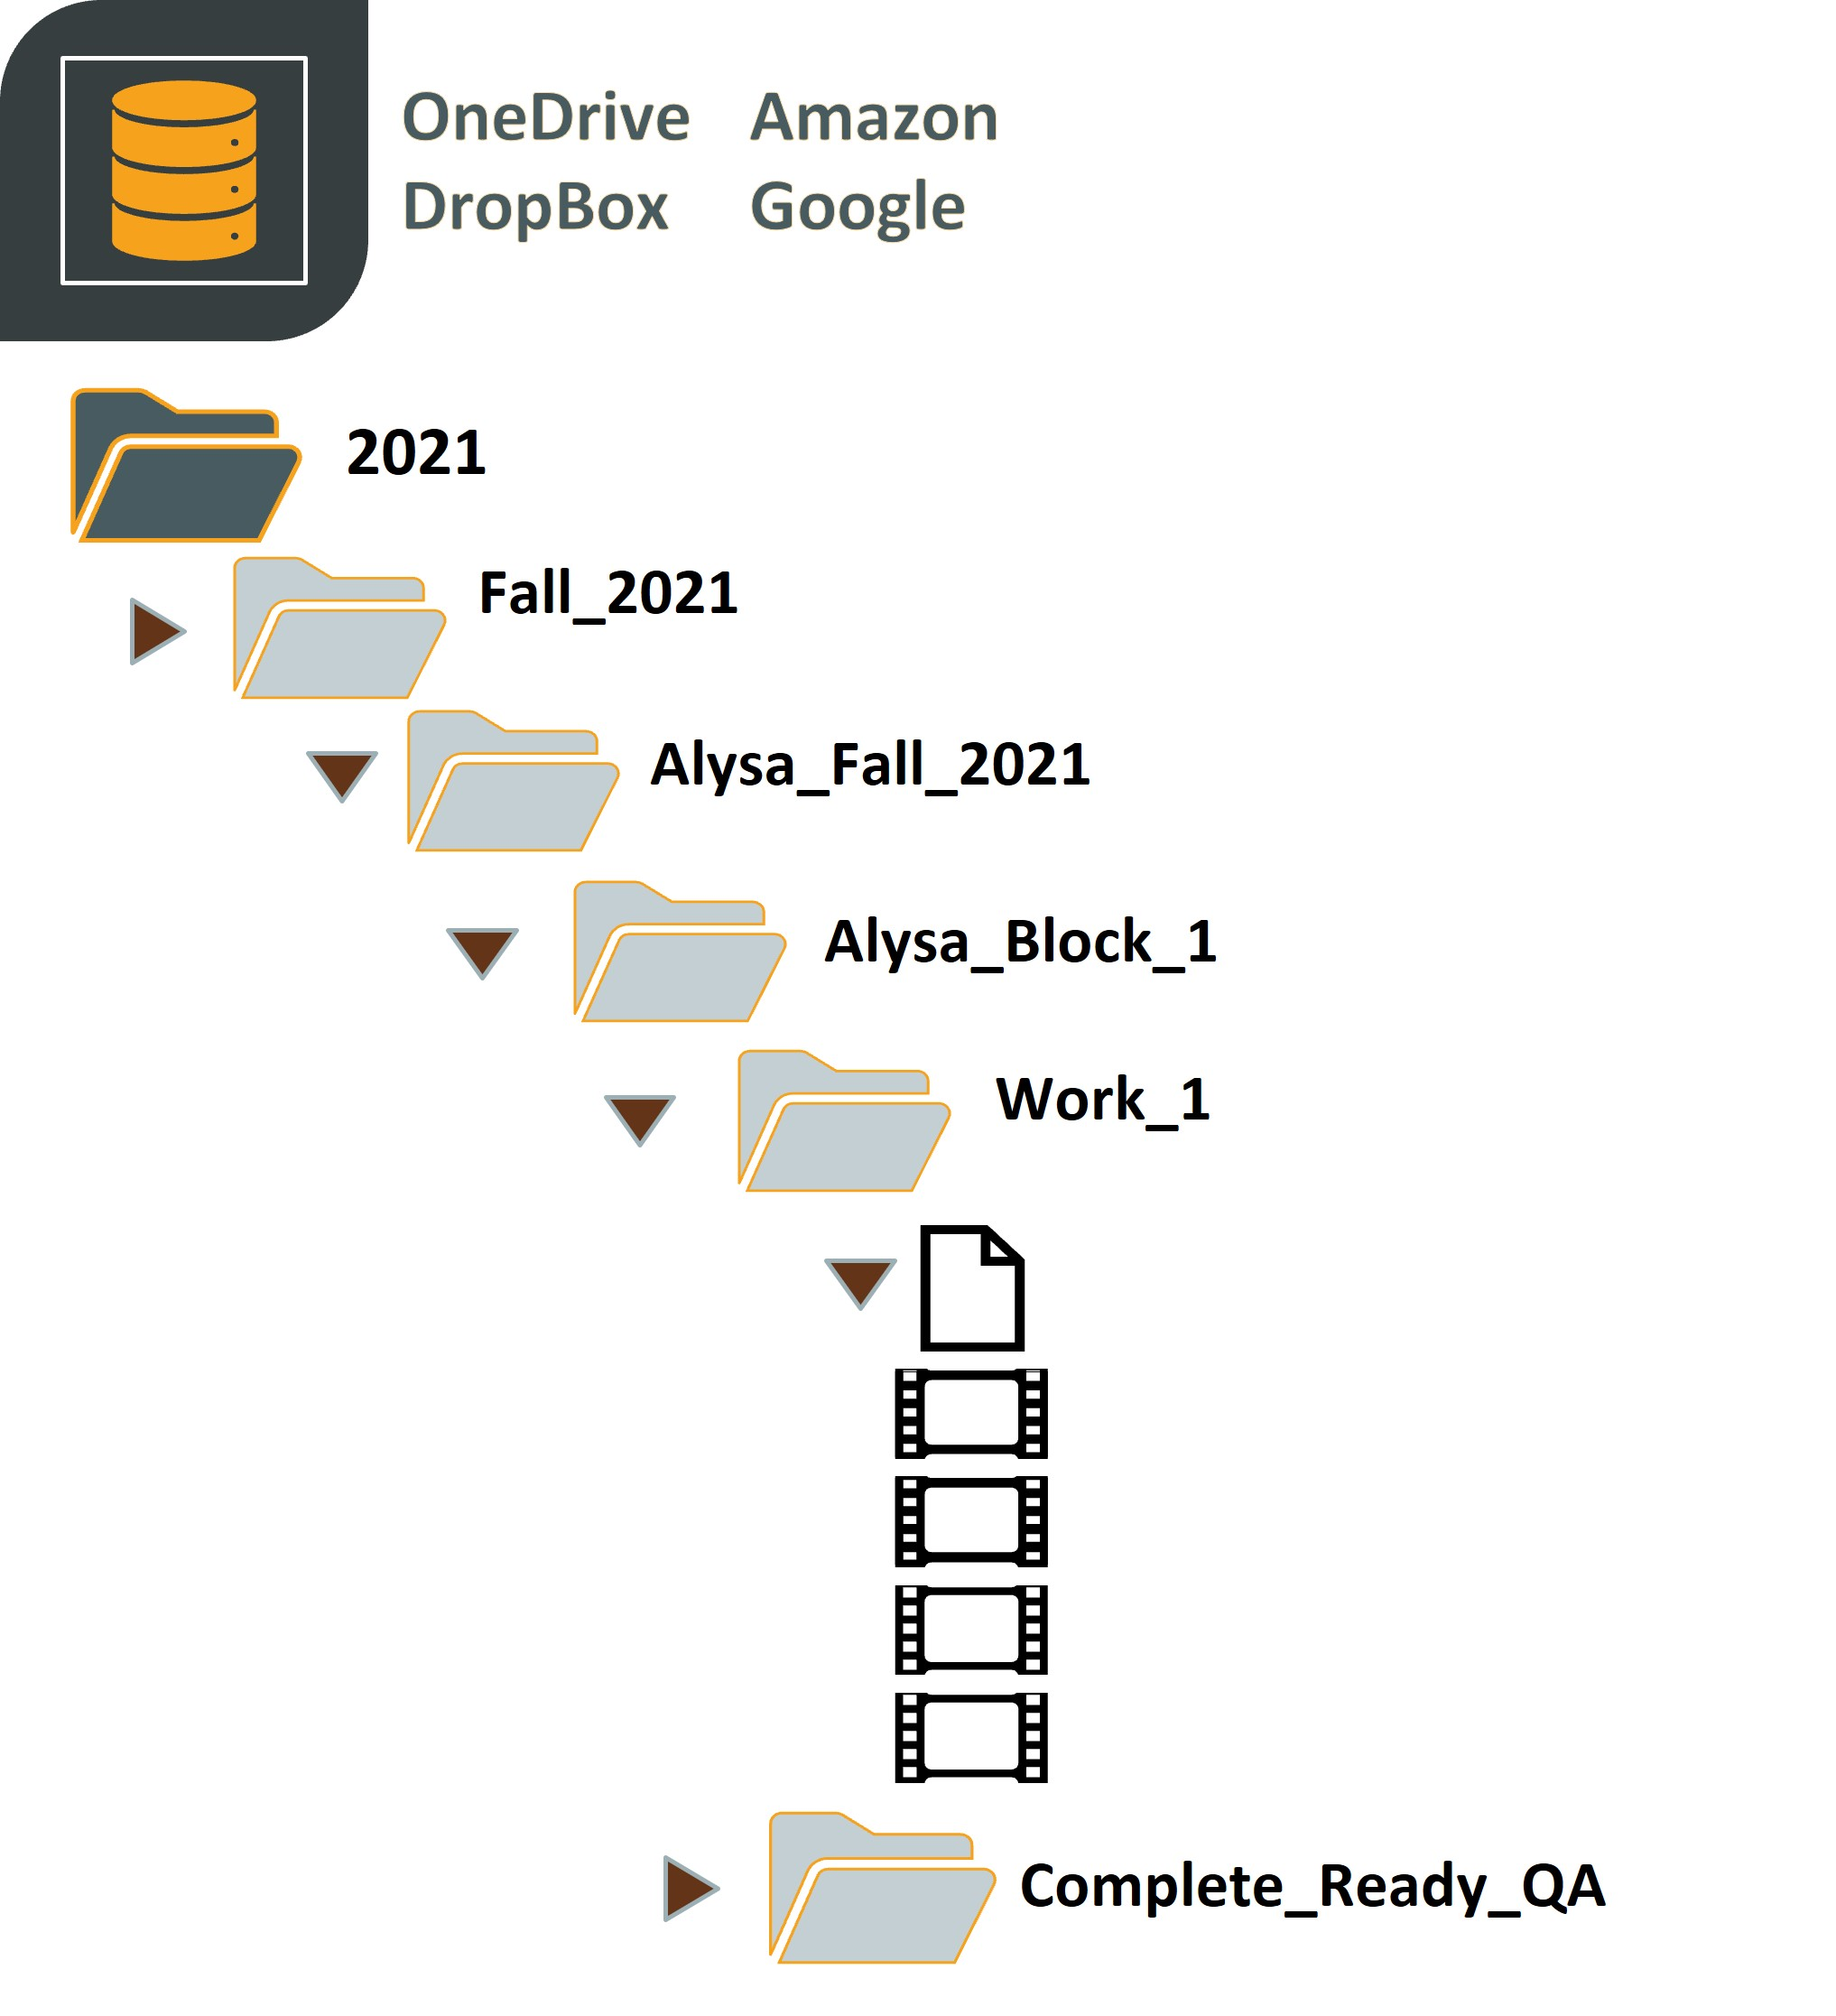
Remote access
Workflow by semester
Internship Students (2021)
Blocks of information
Metadata Template
Videos
Original Scans
Completed work (QA)
Automation – QA - Assignment
Notes:
Due to the pandemic, accessibility to information was limited. After several trials and errors, a customized script was created to align and automate delivery of information via multiple platforms. Students, accessing files from international locations, limited technology available, and other access issues were able to use their preferred access point, instructions, and other tools.
The structure of files were by year/semester followed by the Internship student, working files, tutorials, and other information, along with a delivery folder that triggers notification for QA review.

Slide 37
Linear Reciprocity Workflow
Modularize and implement controls at the micro level to regulate and monitor individual components, processes, and interactions
Standardization, normalization, identification
Notes:
This phase of the (re)processing focuses on the implementation of controls at a more micro level, which proved to take a considerable amount of time. This was the phase where students began to identify irregularities, common grammatical elements and standardization of topics, subjects, offices, names, etc…

Slide 38
standardization
Transform irregularities:
Develop a working thesaurus or word standardization lists to maintain control over terminology and ensure consistency in the representation of concepts across the metadata.
Incorporate ICPSR codes (Inter-University Consortium for Political Science Research) to promote consistency in the classification and categorization of political science-related data.
Establish links between relevant data whenever feasible to enhance the reliability and interconnectedness of the metadata, allowing users to navigate between related resources seamlessly.
Data validation, error detection.
Notes:
Establish standardized metadata index for long-term maintenance, various stages of data cleansing are necessary.
The existing dataset encompasses a substantial amount of information, characterized by its vast scale and complexity
To address these complexities, we applied the following actions:
1.Data cleansing produced better pattern identification once re-applied into incoming work from students
2. We could now develop working thesaurus or word standardization lists to maintain control over terminology
This helped in identification of mis-information, duplications, incorrect data for ads
3. In developing the controlled vocab dataset we incorporated ICPSR codes (Inter-University Consortium for Political Science Research) to promote consistency in the classification and categorization of political science-related data AT BASE LEVEL
* This helped in identifying individuals, locations, campaigns, party affiliation, etc….(name changes, location changes, nicknames, etc…)
* This then allowed us to establish links between relevant data whenever feasible to enhance the reliability and interconnectedness of the metadata, allowing users to navigate between related resources seamlessly.

Slide 39
normalization
Create cohesion:
Ensure uniformity and improve the cohesiveness of the data for long-term preservation
Removing or replacing certain elements in text to achieve a ‘normalized’ representation
Ensure compatibility with various systems and facilitating its accessibility (interoperability)
By normalizing the corpus of information in the archival collection, it becomes possible to conduct data quality checking processes to identify contradictory, inaccurate, or new instances of redundancy.
Notes:
normalization
In the context of this project, text normalization refers to the process of transforming text data into a standardized and consistent format. The goal of text normalization¹ is to ensure uniformity and improve the cohesiveness of the data for long-term preservation, discoverability, and interoperability . This process involves removing or replacing certain elements in text to achieve a standard representation. By normalizing text, it becomes easier to manage and analyze data, ensuring its compatibility with various systems and facilitating its accessibility and understanding in the future.
The consolidation and analysis of the collection's legacy data and amalgamated inventories posed a significant challenge in establishing consistent file identification and managing administrative and descriptive metadata elements. The process of removing redundancies, correcting metadata errors, resolving conflicting entries , and standardizing terminology, substantial improvements were made in data governance and the overall representation of the collection . An additional example of code to use at this phase of the project is videohash.py². This endeavor also led to the discovery of previously unidentified outliers, contributing to a deeper comprehension of the data corpus.

Slide 40
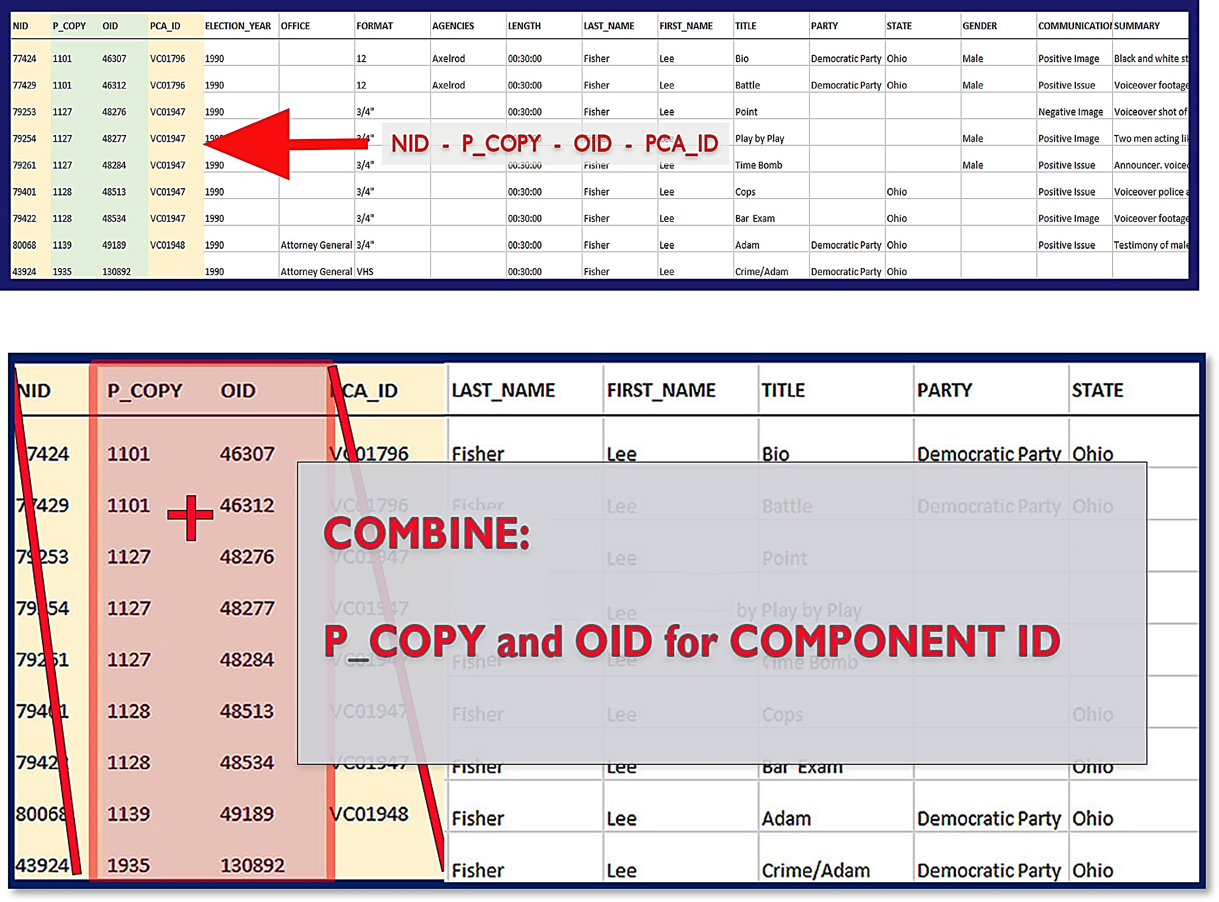
component identification
Notes:
With multiple decades separating many of the acquired materials and entirely different personnel responsible for development of the Collection, information utilized to record collection data has proven to be highly inconsistent. Identifying the most used categorization that signified a sense of order was recognized as a priority when standardizing and formatting the collection. Compiled data analysis helped uncover relationships and associations between the identification numbers and other data elements. This enabled a deeper understanding of how each identification number was utilized and interconnected within the records. During the process of integrating the collection data and formatting the available records, a closer examination revealed the need for a primary and secondary identification number. It became apparent that the P_COPY identification number served as a top-level grouping container, encompassing various item-level components referred to as OID numbers. This insight provided a deeper understanding of the hierarchical structure within the dataset and facilitated more granular analysis and organization.

Slide 41

NEW component identification
Notes:
With multiple decades separating many of the acquired materials and entirely different personnel responsible for development of the Collection, information utilized to record collection data has proven to be highly inconsistent. Identifying the most used categorization that signified a sense of order was recognized as a priority when standardizing and formatting the collection. Compiled data analysis helped uncover relationships and associations between the identification numbers and other data elements. This enabled a deeper understanding of how each identification number was utilized and interconnected within the records. During the process of integrating the collection data and formatting the available records, a closer examination revealed the need for a primary and secondary identification number. It became apparent that the P_COPY identification number served as a top-level grouping container, encompassing various item-level components referred to as OID numbers. This insight provided a deeper understanding of the hierarchical structure within the dataset and facilitated more granular analysis and organization.

Slide 42
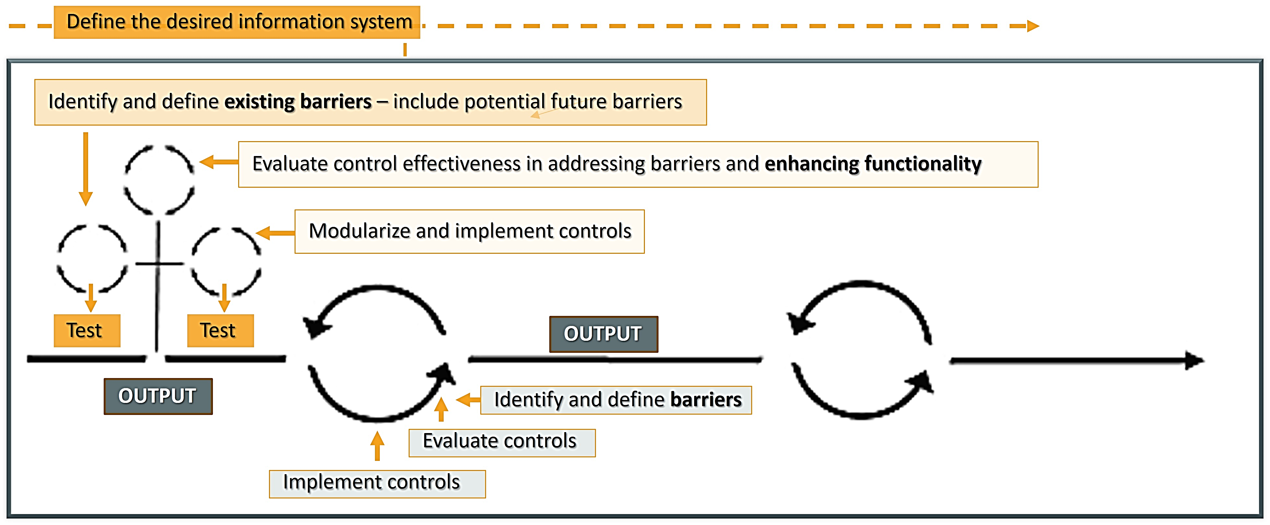
Quick update of workflow
Notes:
The process is repeated throughout each phase with OUTPUTS or results until each AIM or goal has been achieved. The model allows for newly defined barriers to be addressed and solutions or controls developed. As needs or new information is discovered a closed or non-linear model would greatly affect the collection negatively breaking the cyclical flow of information in the system.

Slide 43
Into action
Sample Student Access ‘Groups A-B’ Processes:
Sort sheet by LAST NAME – FIRST NAME (workflow specific)
Implement controlled standardization script to standardize irregularities must be 80% confidence to edit)
Names and nicknames vary for the candidate
ICPSR numbers may vary for the candidate
States may vary for the candidate
Parties may vary for the candidate
Review terms or strings corrected and add extracted text to ‘control sheet-text’.
Implement controlled abbreviations script to standardize all acronyms, short-hand, jargon. Add extracted/corrected text to ‘control sheet-tab abbr.)
Implement error-A_B-1 script (this will export a report with highlighted ‘suggestions, alerts’ for human review.
Clear duplicates from master lists and amend (add parties, states, ICPSR numbers, etc…)
Backup files
Notes:
Refer to the political-commercial-collection-archives repository on Github - https://Github.com/prys0000/political-commercial-collection-archives/

Slide 44
Into action
Sample Student Access ‘Group C’ Processes:
Sort sheet by LAST NAME – FIRST NAME
Run fuzzy-comp-1 script to verify NAMES and ABBREVIATIONS and make sure they are in the CONTROL-SHEET-TAB-TEXT and CONTREOL-SHEET-TAB-ABBRV.
Run error-C-1 script for report of ‘suggested’ alerts, spell checker
Sort sheet LAST NAME – FIRST NAME/OFFICE/ELECTION YEAR
Backup files
Notes:
Refer to the political-commercial-collection-archives repository on Github - https://Github.com/prys0000/political-commercial-collection-archives/

Slide 45
Into action
Sample Student Access ‘QA and Rovers-1’ Processes:
Files will be automatically added to the assigned QA/R folder
Perform data validation and standardization based on the controlled vocabulary with QA-1 script. This script will identify and handle any errors or inconsistencies in the data. This will generate a report highlighting the issues found and suggest possible corrections.
Review report and address issues (save report and notes/changes/alterations made).
Backup files
Notes:
Refer to the political-commercial-collection-archives repository on Github - https://Github.com/prys0000/political-commercial-collection-archives/

Slide 46
Into action
Sample Student Access ‘QA and Rovers-2’ Processes:
Open new metadata worksheet and sort by ‘Component ID’
Open ‘KanterVideos’ folder, CTRL+A, right click SHIFT, copy as path
Paste in new tab in metadata worksheet ‘files’ (CTRL+A, CTRL+H, replace the path leaving the P-#-#.
In metadata sheet copy the Component ID column into the ‘files’ tab next to the just pasted video files.
Select both columns and in excel in the ‘Home’ → ‘Conditional Formatting’ → ‘Highlight Cell Rules’ → ‘Duplicate Values’
Review the files that are in both videos and excel by sorting the columns by cell color, clear the cells leaving only the non-duplicates
---- this will begin a new phase of the project----
Notes:
Refer to the political-commercial-collection-archives repository on Github - https://Github.com/prys0000/political-commercial-collection-archives/

Slide 47
Phase 1
Phase 2
Media File Analysis: Identifying Errors, Corrupted Files, and Component Identification Issues
To be continued…

Slide 48
references
Dietrich, B. J., Crespin, M., Imai, K., Pryse, J. (2023). Campaign television advertisement project. The Evolution of Political Campaign Advertisements. https://s-lib024.lib.uiowa.edu/campaignvids/index.html
Kaid, Lynda Lee; Haynes, J. M.; Rand, Charles E. (1998): Preservation and Access to the Archival Collections of the Political Communication Center, University of Oklahoma: Statement Submitted for the Study of the Current State of American Television and Video Preservation Library of Congress Washington, D.C. Washington, D.C. Available online at https://www.loc.gov/static/programs/national-film-preservation-board/documents/tvoklahoma.pdf
Pryse, J., & Carl Albert Congressional Research and Studies Center. (2023). Julian P. Kanter Political Commercial Collection Project (Version 1.0) [Computer software]. https://Github.com/prys0000/political-commercial-collection-archives
Pryse, Ja. (2021). Practical Remote Workflow Solutions for Complex Digital Projects: Opportunities in a Pandemic. Collections: A Journal for Museum and Archives Professionals. 155019062110527. 10.1177/15501906211052720. https://journals.sagepub.com/doi/full/10.1177/15501906211052720
University of Oklahoma, Lews, M. (2003): OU's Political Commercial Archive Awarded 'Save America's Treasures'' Grant. Available online at https://web.archive.org/web/20040808193404/http://www.ou.edu/pccenter/newsrelease.htm

